Slide 1
Visual tunes
From Playlist Comparisons to Shared Recommendations Through Visualization
Ayush Khaneja
Laxmikant Kabra
Pooja Hegde
Radhika Agarwal

Slide 2

Agenda
Introduction
Datasets
Methods
Comparison
Outcome
Demo

Slide 3
Introduction

Slide 4
Introduction
Music is to express, and connect through expressions
Visual Tunes embarks on a data visualization project centered around Spotify playlists
The main goal is to conduct a comparative analysis of two playlists, unraveling insights into music preferences, trends, and characteristics across genres and artists.
Through the exploration of hidden patterns, we aim to shed light on the diversity of musical styles, offering a fresh perspective on the dynamic landscape of music.
Our ultimate objective is to curate a unified playlist that caters to both users, fostering a deeper appreciation for the universal art form that is music.
4

Slide 5
Motivation
Motivated by the lack of visual elements in Spotify's "Blend" feature, aiming to enhance shared playlist recommendations with visuals.
Inspired by studies suggesting visualizing user preferences improves music discovery in recommendation systems.
Aims to comparatively analyze playlists for multiple use cases.
Seeks to build a flexible tool for trend comparison in music choices.

Slide 6
Datasets

Slide 7
Datasets
Spotify boasts a robust collection of curated playlists and user-generated playlists.
We exclusively require the playlist URLs for data extraction purposes.
Utilizing these URLs, we fetch playlist data from Spotify to Python for analysis.
Post-requisite processing, this data forms the foundation of our extended analysis.
The dataset encompasses information on tracks, artists, length, loudness, popularity, tempo, energy, valence, and more.

Slide 8
Methods

Slide 9
Methods
Utilized Spotipy API to fetch data.
Conducted initial exploration with Python, leveraging Matplotlib and Seaborn.
Experimented with Tableau for visualization purposes.
Explored interactive visualizations using Plotly.
Developed a dashboard using Dash for a comprehensive presentation of insights.

Slide 10
Data exploration and Comparison

Slide 11
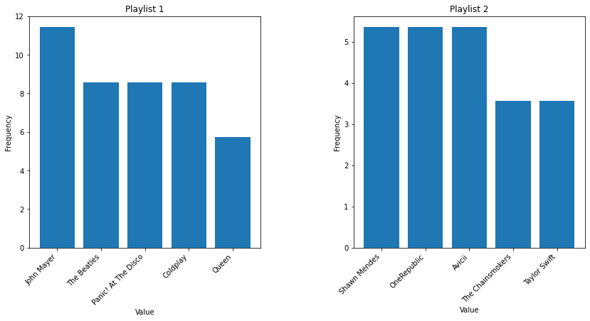
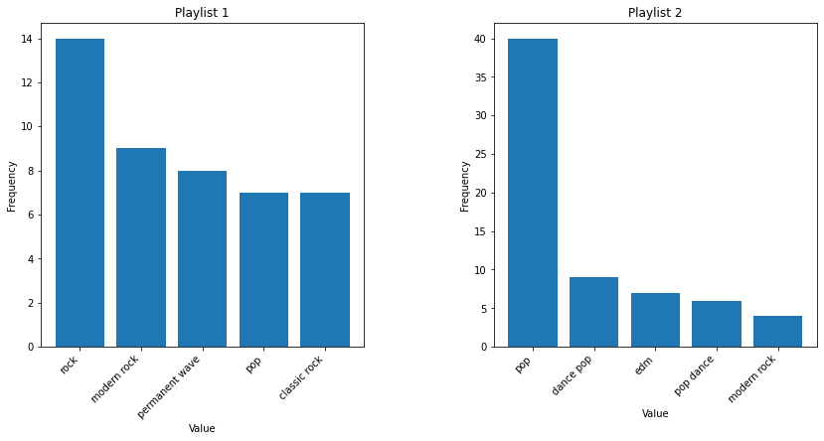
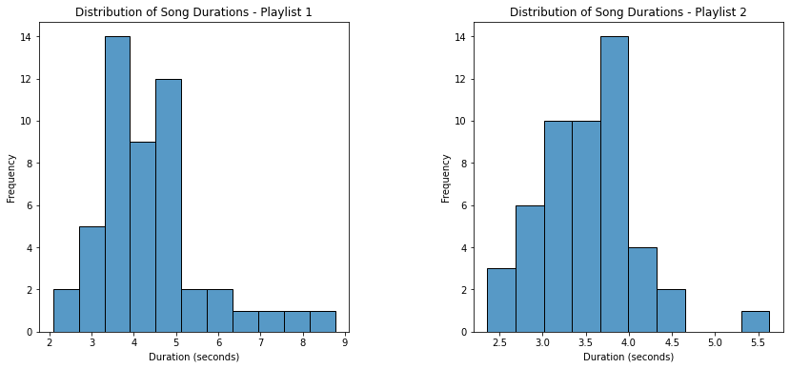
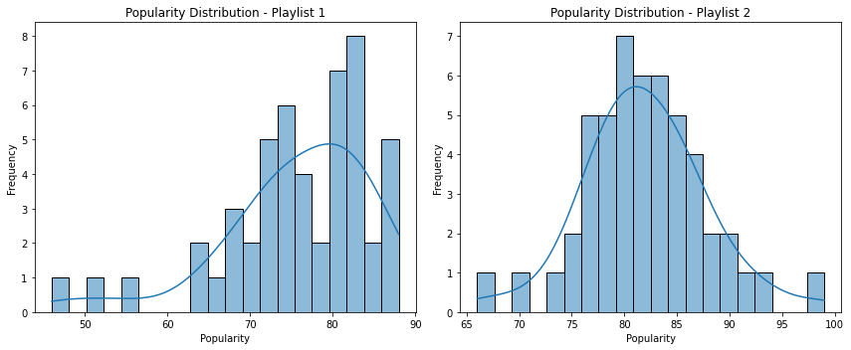
Data Exploration and Comparisons
The plot illustrates the relative occurrence percentages of the top 5 most frequent artists in two playlists through histograms, with Playlist 1 on the left and Playlist 2 on the right.
The plot compares the top 5 genres in Playlist 1 and Playlist 2, displaying their frequencies through sorted bars for visual comparison.
The plot visually contrasts song duration distributions in Playlist 1 and Playlist 2, using the x-axis for duration in seconds and the y-axis for frequency.
The plot visually compares song popularity distributions in Playlist 1 and Playlist 2. Each subplot features a histogram with 20 bins and a kernel density estimate, depicting song frequency at various popularity levels.

Slide 12
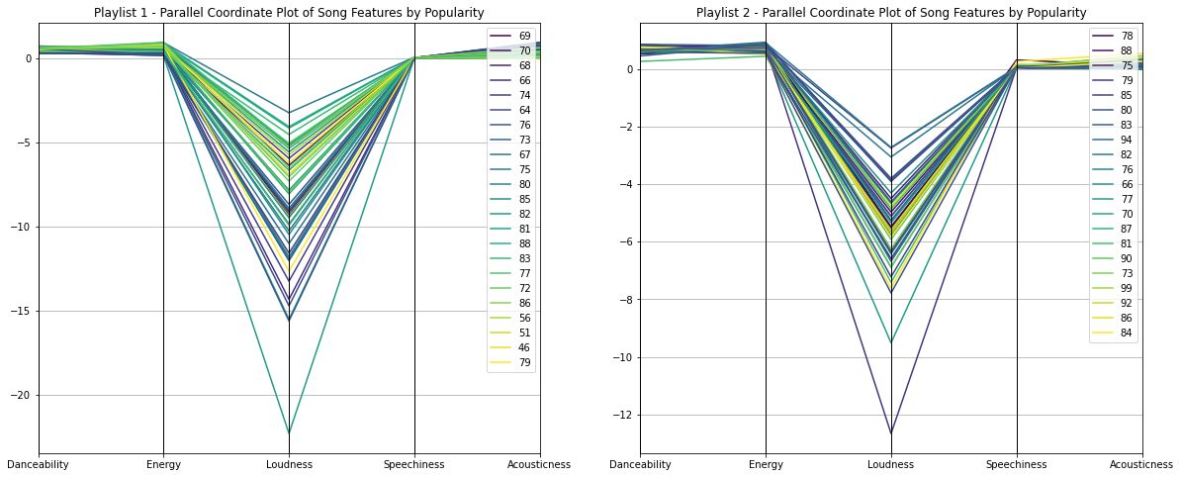
Data exploration
Parallel plots compare song features (Danceability, Energy, Loudness, Speechiness, Acousticness) and popularity levels in Playlist 1 and Playlist 2, using lines to represent songs and color intensity to show popularity.

Slide 13
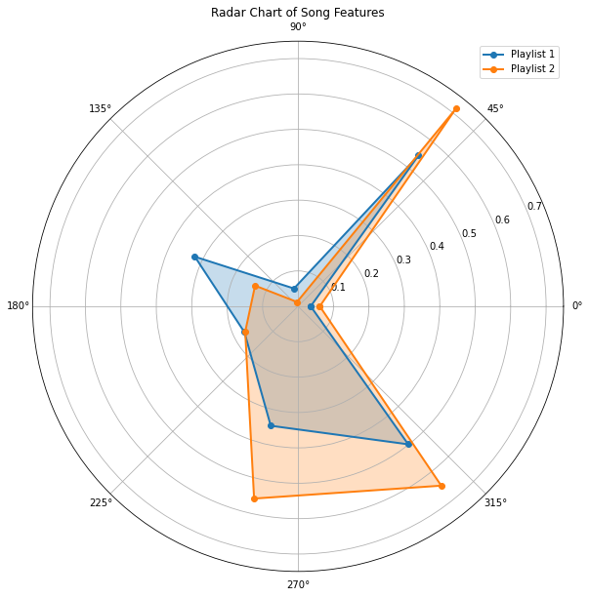
Methods & Data Exploration
The radar chart compares mean values of selected song features in Playlist 1 and Playlist 2, visually highlighting differences in their overall musical characteristics.

Slide 14
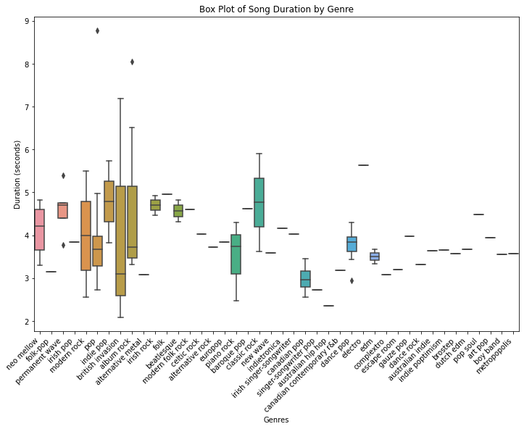
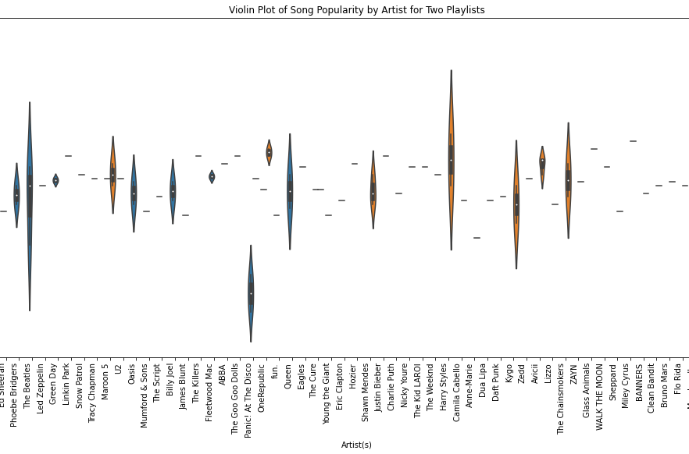
Comparison
The box plot displays song duration distribution across genres, revealing variations and potential outliers in each category.
The violin plot contrasts song popularity distribution among different artists in Playlist 1 and Playlist 2, revealing variations in artist popularity between the two playlists.

Slide 15
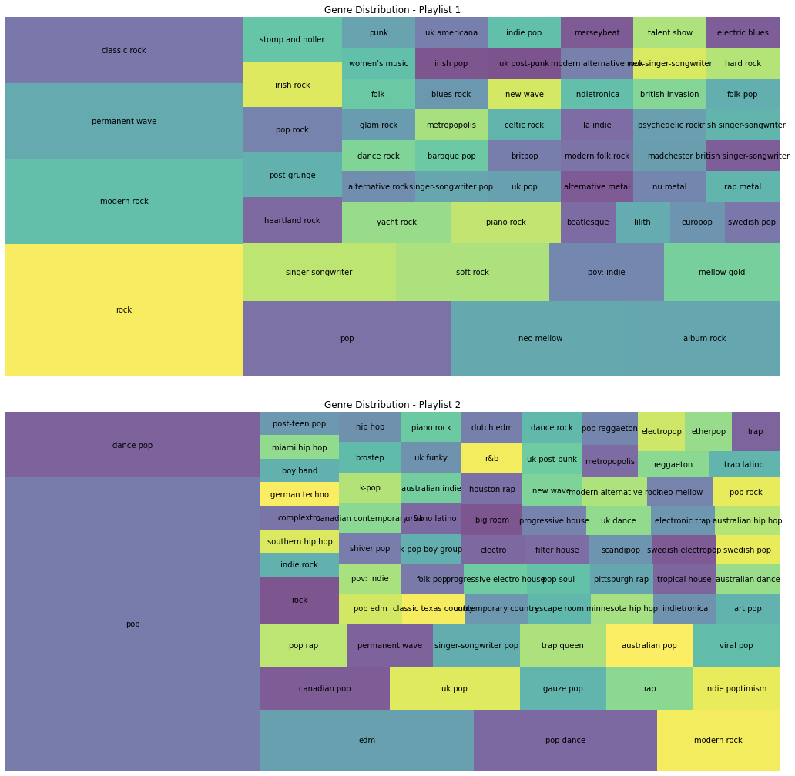
Methods and Data Exploration
The code generates treemaps using the squarify library to visually depict genre distribution of artists in Playlist 1 and Playlist 2. Each square represents a genre, sized proportionally to the number of artists. The plots offer an overview of genre diversity within each playlist.

Slide 16
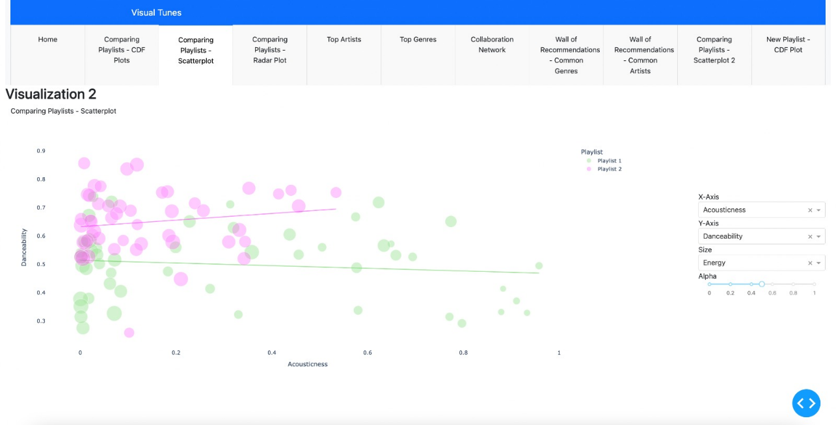
Visualizing using Plotly
Scatterplot compares songs from two playlists, allowing user control over axes and scatter size based on variables. Gestalt principles aid multidimensional pattern perception, emphasizing balance for cohesive insight.

Slide 17
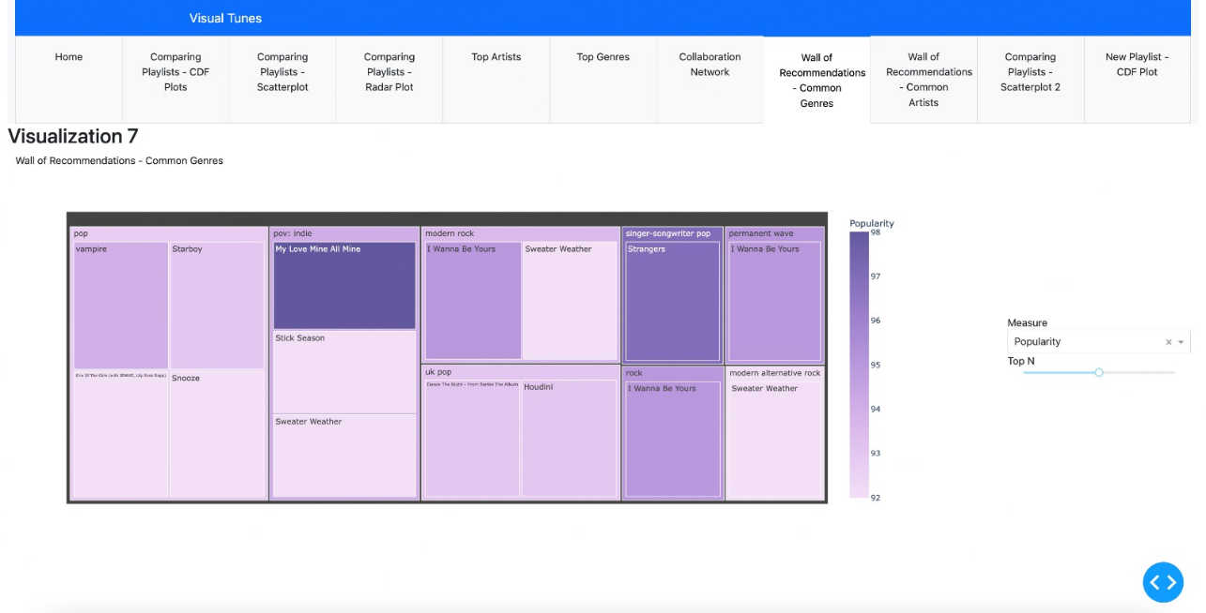
Visualizing using Plotly
Treemap visualizes top recommended songs in common genres, allowing users to control display quantity and selection measure for box size and color. Nested rectangles aid hierarchical data visualization.

Slide 18
Outcome

Slide 19
Outcome
Diverse visualizations, such as scatterplots and treemaps, analyze and compare song features in playlists.
User-friendly controls, like sliders and selection measures, enhance the interactive experience.
Gestalt principles guide the design for effective pattern perception and grouping continuity.
Considerations for balance and restraint are emphasized to avoid cognitive overload and disjointed disruption.
Insights into music data are derived from multidimensional visualizations, promoting intuitive understanding.

Slide 20
Team
Ayush
Khaneja
Laxmikant Kabra
Pooja Hegde
Radhika Agarwal

Slide 21




Thank you
Presenter name
Email address
Website

Slide 22
YouTube video link
https://youtu.be/GEAbczA0TQI

